Slide 1


Slide 2
Introduction to Networking

Slide 3
Overview
By the end of this module you should have developed an understanding of:
Basic networking (devices and topology)
Device addressing – IPv4, MAC, Port Numbers
Accessing network services
Remote terminal access.

Slide 4
Networking
A network is a set of interconnected devices.
Devices can be grouped into one of two general categories:
End devices
Laptops, workstations, servers, IP phones, PDAs, tablets, ...
Intermediary devices
Switches, routers and other specialized devices used to interconnect and monitor end device

Slide 5
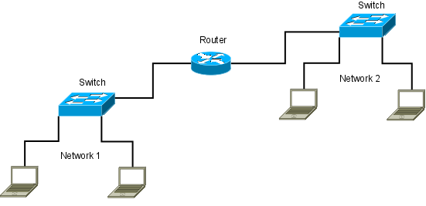
Networking - Intermediary Devices
Switches connect end and intermediary devices together to form a network.
Routers connect networks together and separate subnetworks (subnets).

Slide 6
Networking
Connections between devices are formed using some sort of physical media:
Copper, Fiber, Wireless
Formal rules govern formatting and transmission of data across these physical media.
These set of rules are known as protocols.
For example, http, tcp, ip, and ethernet protocols all work together to transport a page from a web server to your browser.

Slide 7
Device Addressing
Three types of addressing may be required for device to device communication:
MAC Address
IP address
Port Number

Slide 8
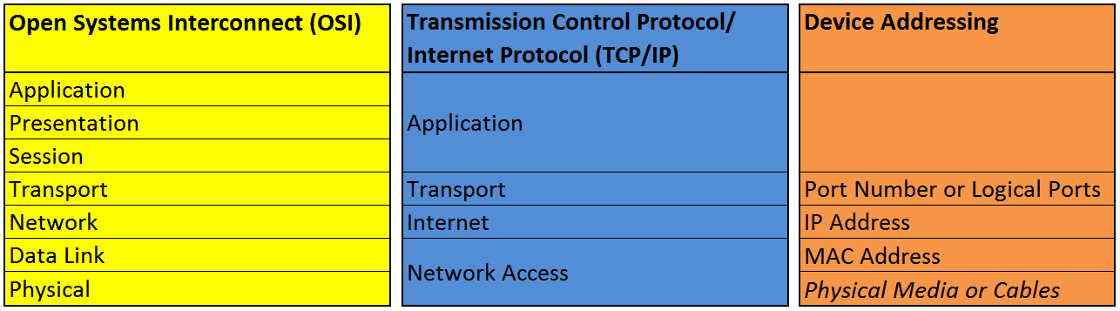
OSI and TCP/IP Models
These two network reference models are a conceptual framework of how applications and protocols communicate over a network

Slide 9
MAC Addressing
The Media Access Control (MAC) address is a unique 48 bit (6 byte) number used to identify the physical network interface of any communicating Ethernet device.
Normally presented in hexadecimal
00:00:00:00:00:00
ff:ff:ff:ff:ff:ff
The separator can be colons or dashes

Slide 10
MAC Addressing
The first 3 bytes are used to identify the manufacturer. The last 3 bytes uniquely identify the device.
All MAC addresses are unique

Slide 11
MAC Addressing
To display your MAC Address in Windows at the command line, use
Ipconfig /all
To display your MAC Address in Linux at the command line, use
ifconfig
ip addr and look for link/ether

Slide 12
IPv4 Addressing
An Internet Protocol (IP) address is a number assigned to a computer that allows it to participate in a computer network that supports this technology
For example the 32 bit binary number:
11000000101010001000000110000001
is a valid IPv4 address.
Although it is common to work with IPv4 addressing in binary, the binary string can be difficult to remember

Slide 13
Internet Protocol Version 4
For us humans, the bits of a 32 bit IP address are divided into 4 groups of 8 bits known as octets.
Each octet is separated by a dot ( . ) giving the IPv4 address its general form:
xxxxxxxx.xxxxxxxx.xxxxxxxx.xxxxxxxx
where each x represents the position of a bit.
This is referred to as dotted decimal notation

Slide 14
Internet Protocol Version 4
Each bit within an octet is assigned a value based on its position within that octet:
2⁷ 2⁶ 2⁵ 2⁴ 2³ 2² 2¹ 2⁰
128 64 32 16 8 4 2 1
x x x x x x x x
When a bit is set to 0 (off), we ignore the value of that position, otherwise we calculate the value for that position and add it to our total for the octet.
Each octet has a valid range of values of 0 to 255

Slide 15
Internet Protocol Version 4
Octet examples:
2⁷ 2⁶ 2⁵ 2⁴ 2³ 2² 2¹ 2⁰
128 64 32 16 8 4 2 1
0 0 0 0 0 0 0 1 = 1
0 0 0 0 0 0 1 0 = 2
0 1 1 1 1 1 1 1 = 127
1 0 0 0 0 0 0 0 = 128
Since our IPv4 address is defined by four octets:
2⁷ 2⁶ 2⁵ 2⁴ 2³ 2² 2¹ 2⁰. ... . ... . 2⁷ 2⁶ 2⁵ 2⁴ 2³ 2² 2¹ 2⁰
[0-255].[0-255].[0-255].[0-255]

Slide 16
Internet Protocol Version 4
IPv4 addressing is divided into public, private, and reserved addressing
Public addressing is used by systems directly connected to the internet. These are also known as routable addresses
Private addressing is used by organizations to isolate private systems from the internet
Reserved addressing is meant for testing and is not available to most users and organizations

Slide 17
IPv4 Address Classes
Can be identified by the value of the first octet
Class A
First octet is in the range of 1 to 126
Examples: 10.10.60.80, 120.98.147.5
Class B
First octet is in the range of 128 to 191
Examples: 129.37.58.1, 190.58.12.120

Slide 18
IPv4 Address Classes (con’t)
Can be identified by the value of the first octet
Class C
First octet is in the range of 192 to 223
Examples: 210.50.10.20, 192.168.202.51
Class D (reserved for multicast addresses)
First octet is in the range of 224 to 239
Examples: 224.0.10.255, 239.255.0.254
Class E (reserved for experimental purposes)
First octet is in the range of 240 to 254

Slide 19
IPv4 Addressing
The number of network and host bit varies for each IPv4 address classes
Class A
nnnnnnnn.hhhhhhhh.hhhhhhhh.hhhhhhhh or N.H.H.H
Class B
nnnnnnnn. nnnnnnnn.hhhhhhhh.hhhhhhhh or N.N.H.H
Class C
nnnnnnnn. nnnnnnnn. nnnnnnnn.hhhhhhhh or N.N.N.H
Legend: n – represents one network bit h – represents one host bit
N – represents eight network bits H – represents eight host bits

Slide 20
IPv4 Address Prefixes
The prefix specifies the consecutive number of bits, from left to right, used to identify the network bits of the address.
Example: 192.168.100.10 /24
Class A default prefix is /8
nnnnnnnn.hhhhhhhh.hhhhhhhh.hhhhhhhh
Class B default prefix is /16
nnnnnnnn. nnnnnnnn.hhhhhhhh.hhhhhhhh

Slide 21
IPv4 Address Prefixes
Class C default prefix is /24
nnnnnnnn. nnnnnnnn. nnnnnnnn.hhhhhhhh
Class D
No subnet mask is associated with this class
Class E
No subnet mask is associated with this class

Slide 22
IPv4 Subnet Masks
The subnet mask can be identified from the prefix by assigning a value of 1 to the network bit and converting it to decimal number system.
Class A default prefix is /8
nnnnnnnn.hhhhhhhh.hhhhhhhh.hhhhhhhh
11111111.00000000.00000000.00000000 = 255.0.0.0
Class B default prefix is /16
nnnnnnnn. nnnnnnnn.hhhhhhhh.hhhhhhhh
11111111. 11111111.00000000.00000000 = 255.255.0.0

Slide 23
IPv4 Subnet Masks
Class C default prefix is /24
nnnnnnnn. nnnnnnnn. nnnnnnnn.hhhhhhhh
11111111. 11111111. 11111111.00000000 = 255.255.255.0
VLSM (Variable Length Subnet Masking) was introduced to conserve ip addresses by allowing ip address classes to be divided into smaller networks
This means that ip addresses do not have to have the classful mask (/8, /16, /24)

Slide 24
IPv4 Subnet Masks
Examples:
IP address: 192.168.56.1 /24 Subnet Mask: 255.255.255.0
IP address: 172.30.40.50 /16 Subnet Mask: 255.255.0.0
IP address: 172.30.40.50 /25 Subnet Mask: 255.255.255.128
IP address: 169.82.47.12 /30 Subnet Mask: 255.255.255.252

Slide 25
Private IPv4 Addresses
Private addresses – used within the network or local area network.
Class A - 10.0.0.0 /8
Valid from 10.0.0.0 to 10.255.255.255
Class B - 172.16.0.0 /12
Valid from 172.16.0.0 to 172.31.255.255
Class C - 192.168.0.0 /16
Valid from 192.168.0.0 to 192.168.255.255
These address classes were introduced to increase the longevity of IPv4
Private addresses cannot be used on the Internet

Slide 26
IPv4 Addressing
Public addresses are any address that do not belong to the Private Address Ranges. These addresses are routable which means they can be used on the Internet
Special Addresses
Loopback: 127.0.0.0 /8
Link Local: 169.254.0.0 /16

Slide 27
Viewing IP Configuration
Open a PowerShell or command line prompt and type:
ipconfig
/all
/release
/renew
Open a Bash prompt and type:
ifconfig
ip addr

Slide 28
IPv6 Addressing
IPv6 has been introduced to expand the number of ip addresses available
IPv6 uses hexadecimal instead of binary
IPv6 is 32 hexadecimal values or 128 bits (IPv4 is 32 bits)
An example of an IPv6 address is:
2001:0DB8:0000:1111:0000:0000:0000:0200
Colons or dots can be used as separators

Slide 29
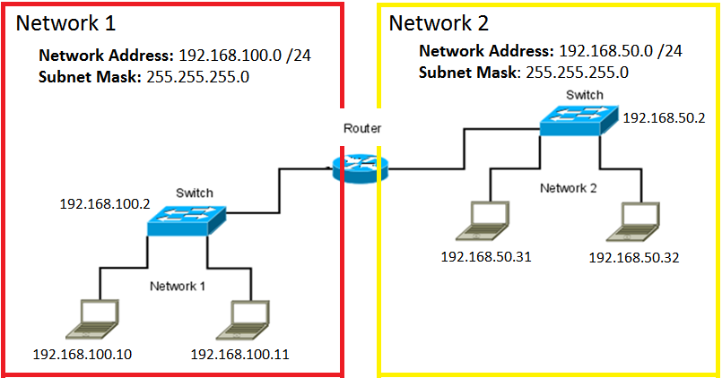
Computer Networks
The network address can be used to identify the IPv4 addresses within the network
Gateway for Network 1
Gateway for Network 2

Slide 30
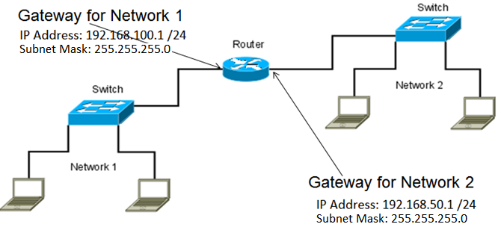
Default Gateway
A gateway or default gateway is a router interface connected to the same network as your device
This specific router interface is configured to manage your traffic to and from destinations on remote networks

Slide 31
Viewing Gateway Configuration
The Windows ipconfig command displays the current default gateway IPv4 address.
You may also use the route command on either operating system to view gateway information:
At a command Prompt, type:
route print -4
The -4 will print only IPv4 information
In Bash, type:
route (or /sbin/route as a regular user)

Slide 32
Viewing Gateway Configuration
You will notice an ip address of 0.0.0.0 in the route output
This is referred to as quad zero
A destination of 0.0.0.0 is used to match all networks.
This entry (translated to default in Linux route output) lets us route traffic to networks for which a more specific route is not available

Slide 33
Port Numbering
Used to identify a specific application on a device
range from 0 to 65535
For example:
22 (ssh)
80 (http)
443 (https)
To access a specific application running on a system, you may need to specify the port number in the URL. For example:
www.abc.org:8080

Slide 34
Port Numbering
A local list of assignments can be accessed in Bash with:
cat /etc/services | less
and in Power Shell with:
get-content c:\Windows\system32\drivers\etc\services | more

Slide 35
Network Services
Various network services must be in place for a computer work within a networked environment.
Devices may be named on the network
Common services are:
Domain Name Services (DNS)
Dynamic Host Configuration Protocol (DHCP)
Remote Access

Slide 36
Host Names
Host names are labels assigned to networked devices by the system administrator.
These labels can be used to identify the device in various forms of communication.
Host names consist of a simple name, such as workstation1, but may also include domain information such as workstation1.opsys.bit
You can view and set a system's host name with the hostname utility.

Slide 37
Host Names
hostname with no options or arguments will return your complete hostname.
hostname <new_name> will change the system's current host name to <new_name>
Options:
hostname -d will return only the domain
hostname -s will return only the host portion of the domain name.

Slide 38
Domain Name Services
Domain name services (DNS) are used to map names to ip addresses.
Names such as rrc.mb.ca must be converted into numerical addresses
These addresses are then used to establish connections and transfer information.
Without this service, we would have to enter the numeric address of every device we wanted to communicate with.
Both Windows and Linux use versions of the nslookup utility enable user DNS queries

Slide 39
Domain Name Services
nslookup has two modes: interactive and non-interactive
Non-interactive mode is used to print just the name and requested information for a host or domain
Forward lookup:
nslookup ranier.academic.rrc.ca
Reverse lookup:
nslookup <ranier's ip-address>

Slide 40
Domain Name Services
Interactive mode allows the user to query name servers for information about various hosts and domains.
The following commands should be run in both command line and Bash
type nslookup and press <enter>
set all will display a list of servers and options that are currently configured.
server <server-ip> or
server <server-name> will change the server that nslookup uses to request information.

Slide 41
Viewing Domain Information
The Linix whois utility will return information about certain domains
This command can also be used on Windows at a command prompt
You can run the whois command in a browser

Slide 42
Viewing Address Information
The whois utility can also be used to determine ownership of a particular IP address.
For example, nslookup rrc.mb.ca tells us that this address is linked to 198.163.144.50
Opening a browser and entering this IP address into the address bar takes us to the college's main web page.
Executing whois 198.163.144.50 tells us that this address is registered to Red River College.

Slide 43
Configuring DNS
/etc/resolv.conf is the configuration file that is used to determine which DNS servers are to be queried when a look-up is required.
cat /etc/resolv.conf
The keyword search tells the system to append the listed domain if only a simple host name is provided.
For example:
search rrc.mb.ca rrc.ca mb.ca ca

Slide 44
Configuring DNS
Executing nslookup google will sequentially search google.rrc.mb.ca google.rrc.ca google.mb.ca and google.ca until an address is returned or all options are exhausted.
Each nameserver entry in the /etc/resolv.conf file identifies a server to be queried.
nameserver 10.20.30.2
nameserver 10.20.30.3

Slide 45
Configuring Network Interfaces
In most cases we simply tell our device to obtain the required information automatically, if possible.
In this case we rely on a network service known as the Dynamic Host Configuration Protocol (DHCP)
Key information provided to a host by this network service:
IP address and subnet mask
Gateway
DNS Servers

Slide 46
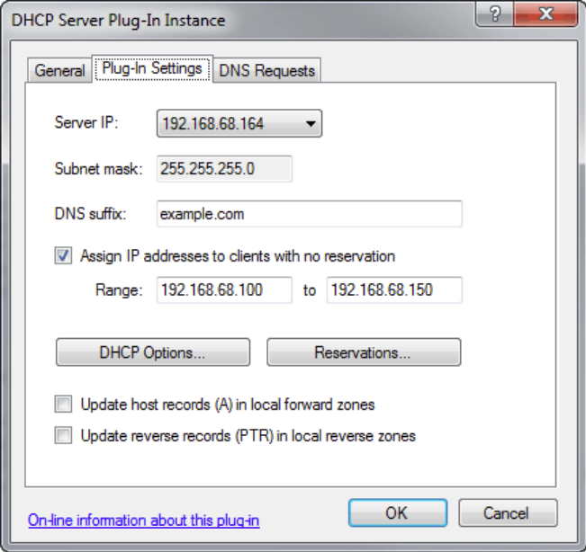
Configuring Network Interfaces
Dynamic Host Configuration Protocol (DHCP)
The server will
automatically assign an IPv4
to computer within the
configured pool of addresses
(e.g. range is from
192.168.68.100 to
192.168.68.150).
Microsoft Server’s DHCP Server Configuration

Slide 47
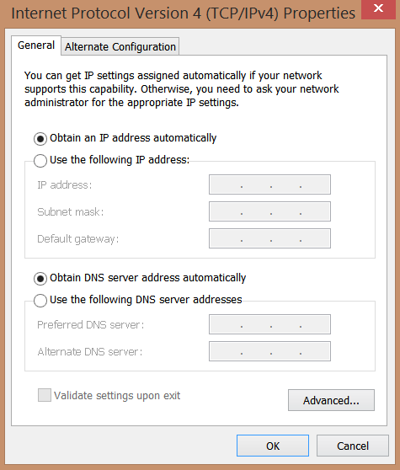
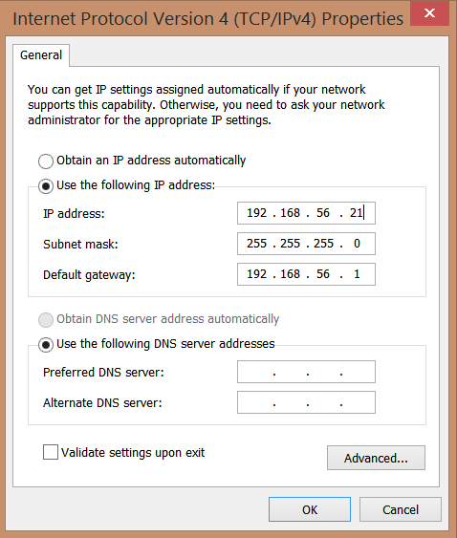
Configuring Network Interfaces
IP address can be either dynamically obtained or statically (manually) assigned.
Control Panel > Network and Sharing Center > Change Adapter Settings > Ethernet > Properties > Internet Protocol Version 4 (TCP/IPv4)
DHCP or dynamically obtained
Manually assigned

Slide 48
Configuring Network Interfaces
Several options for configuring network interfaces are available under Linux. You may:
manually edit Debian's configuration file
/etc/network/interfaces
use a command line utility
ifconfig
ip
ifup and ifdown
use a graphic utility

Slide 49
Configuring Network Interfaces
Network interfaces are named and numbered.
Names help us label each interface according to network type.
eth labels Ethernet interfaces and wlan labels wireless interfaces
Numbering starts at zero and is used to distinguish multiple interfaces for a particular network type.
eth0
wlan0

Slide 50
Interface Commands: ifconfig
Commonly used, but obsolete, command used to view and configure network interfaces.
ifconfig [ interface ] [ options ]
If no interface or options are specified, will return detailed information for all available interfaces.
Specifying and interface will provide detailed information for that interface only:
ifconfig eth0

Slide 51
Interface Commands: ifup/ifdown
The ifup and ifdown commands allow us to reliably enable and disable interfaces under Debian. For example:
ifdown eth0
will disable the eth0 interface. Use ifup to re-enable the interface:
ifup eth0
If the interface is configured for DHCP, the system will attempt to obtain a DHCP lease from the attached network.

Slide 52
Interface Commands: ip
The ip command is used show and manipulate networking information
ip [ OPTIONS ] OBJECT { COMMAND | help }
Several objects are available, but we are only interested in at this point are addr and link
To show detailed information for all available network interfaces, use the command:
ip addr

Slide 53
Interface Commands: ip
As with ifconfig we can change the state of a network interface:
ip link set eth0 down
ip link set eth0 up

Slide 54
Remote Terminal Access
Telnet and SSH are protocols that enable logging into and executing commands on remote machines.
Both protocols are implemented using a client/server model.
SSH (Secure Shell) was developed to provide authentication and security for TCP/IP applications
Telnet is inherently insecure and should only be used when ssh is not available.

Slide 55
Remote Terminal Access
The OpenSSH project provides Unix-based systems with open-source client and server software (http://www.openssh.com/)
Client usage:
ssh [ options ] [user@]host
Options include:
-X enable X11 forwarding
-p specify a port other than 22

Slide 56
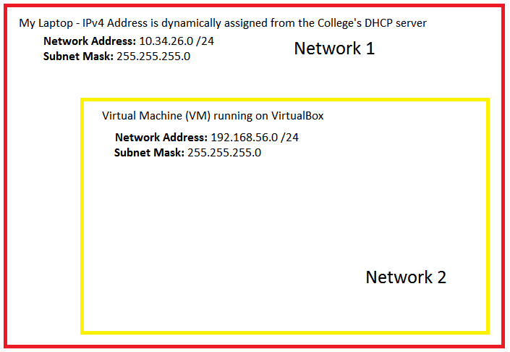
Our Virtual Network Setup
Virtualized environment scenario depicting two networks

Slide 57
Remote Terminal Access
We will be using a utility called PuTTY for remote terminal access from the Windows virtual machine to access the Debian virtual machine
We will be using SSH for the access so the SSH service must be started on Debian in order to allow the access
To start the SSH service on Debian, enter the following command
service ssh start

